Slide 1
Distance Sponsorship

Slide 2
The Beginning of DSS
UKFD took on task of developing A tool of Distance Sponsorship to support South West of United Kingdom.
Taken from UKFD Min’s ( Ade to organise the Prison Sponsorship as has previous dealings with H&I prison sponsorship. We hope to use the same model. Adie to bring pack to next FDC meeting ready for UK Region.) 03/08/2014

Slide 3
DSS Guidelines
United Kingdom Fellowship
Development Committee
GUIDELINES FOR SPONSORS:
The following are guidelines for us to follow when sponsoring NA members seeking recovery through the 12 steps of NA.
In our introduction we qualify ourselves as addicts so that the addict can get to know and identify with us. We let them know we are willing to correspond with them by Skype , Any technology, letter, email, and phone or by any other means available and to act as a sponsor in order to guide them through the 12 steps.
Two years clean time.
Have an NA Sponsor.
Have experience of working the 12 Steps of NA.
We let them know that Sponsorship helps us as much as it helps them and that they are no longer alone.
We stay focused on recovery, offering them the solution not the problem.
Encourage them to attend any meetings.
In the spirit of our 12th tradition we respect the anonymity of all Sponsee’s.

Slide 4
DSS Questionnaire.
FELLOWSHIP DEVOLOPMENT COMMITTEEE
Region Distance Sponsorship Form
Our goal for this Task.
Our goal is to establish a Distance Sponsorship Committee to provide sponsorship in areas that NA members have difficulties finding people to sponsor them and take them through the 12 steps of Narcotics Anonymous.
Dear Prospective Sponsor:
Thank you for your interest in the Area Sponsorship programme in NA. We are very excited about carrying the message of recovery, through sponsorship in our communities, and your willingness to participate. As you might imagine we need to take great care to conduct ourselves in a spiritual manner as maintaining as much of our anonymity as possible. The committee will receive requests from addicts in areas that struggle to find NA sponsorship and match them up with a sponsor as soon as possible. We need to know a little bit about you to make the best possible match. Please answer the following questions as completely as you can.
(Please download this document and type your answers in the spaces underneath each question. Then save and send back via email as an attachment.)
Please print your name and address, with a phone number as well.
What pen name would you like to be known by?
How is your recovery based in Narcotics Anonymous?
Have you completed a Fourth and Fifth Step out of Narcotics Anonymous Literature?
Do you attend NA meetings regularly?
Do you have at least two continuous years clean time?
Do you have a clear working knowledge of the Twelve Steps and Twelve Traditions of NA? Do you have experience being an NA sponsor? Please describe.
Do you have all the means to provide stationary and stamps for correspondence, face to face, phone or even skype?
Do you have the willingness and availability to reply to any letter, meeting up, step work etc. you receive within two weeks?
Have you spoken with your NA sponsor about becoming involved with this avenue of service?
Please provide us with your sponsor’s contact details, as we may need him/her to vouch for you?
Thanks for taking the time, and being honest enough to answer all of these questions. We will let you know if a prospective Sponsee writes in that might be suitable for you.
ILF
UKFDC

Slide 5
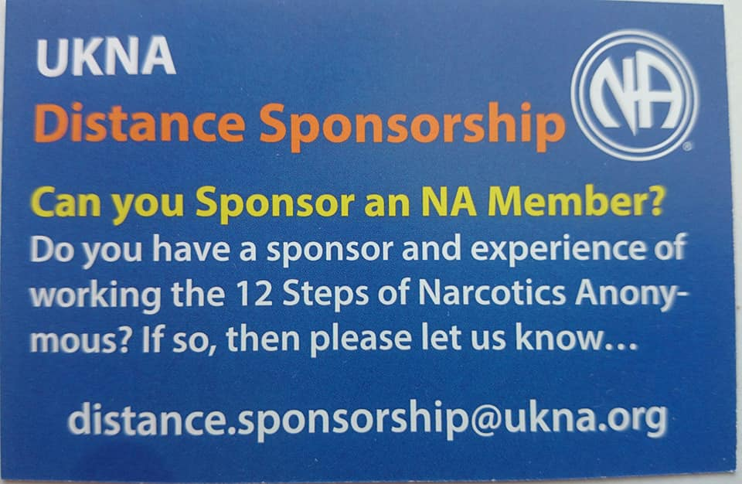
How does it work?

Slide 6
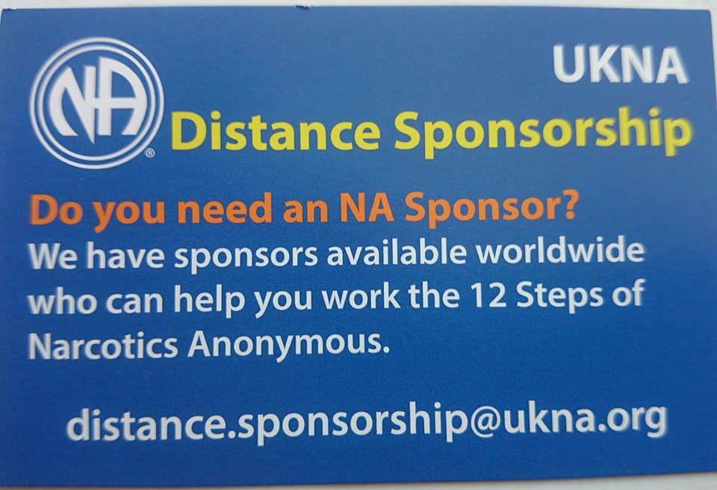
Business Cards Of DSS

Slide 7

Distance.sponsorship@ukna.org

Slide 8
Getting DSS Out There
http://ukna.org/content/fellowship-development
Distance.sponsorship@ukna.org
On-line meetings
Home group’s
NAWS
EDM
Region’s
Area’s
Flyers & Business Cards
Word & mouth
Workshops
Rural Outreach (webinars)
Social Media

Slide 9
Sponsor & Sponsee
Emails
Skype
Phone
Social media Apps
Post
Face to face

Slide 10
Challenge’s
Rural Country’s & Area’s
Lack of up to date technology (Wi-Fi, phones)
Cultural difference’s and Language’s
Communication
Non Approved NA Literature
Judgements by members

Slide 11
Logistics
Ratification
Linking Sponsor to Sponsee
Committee decision’s
Problem’s
Financial Running Cost
Regional Reports
Effective Communication
Aim to find sponsee a sponsor in 72 hrs
Support from UK Region, UK Website EDM & NAWS

Slide 12
Task By NAWS to Support Africa
01/05/2016 Beginning in support Africa in Distance Sponsorship.
Egypt
Kenya
Nigeria
Uganda
Tanzania
South Africa (many area’s of SA)
Saudi Arabia

Slide 13
Country's Of Sponsor/Sponsee
United Kingdom
Norway
Sweden
Holland
Germany
Switzerland
Thailand
USA
Chile
Brazil
New Zealand
Australia
Russia
India
Demark
Egypt
Saudi Arabia
Africa (many parts of Africa)
Hungry
Bosnia
France
Poland
Belarus
Greece
Argentina
Turkey
Maldives
Nepal
Spain
Ireland
Pakistan
Guernsey
Jersey
Cambodia

Slide 14
New Developments In DS
Other great work that DS has been going on behind the screens. I have make contact with South Dakota USA ISOLATED & RURAL NA 9 Indigenous Native American Indian Reservations in our state. Region: South Dakota Region Area: West River Area, I have make contact and with the RD there and working on building bridges to support the Indigenous Native Americans.
I have been working alongside the Egyptian Fellowship Development and supporting them set up their own DS and with also experience of DS worldwide. The Egyptian FD now have set up “Loners group” to support and sponsor members.
Been in contact with NAWS and will be attending webinar’s on Rural outreach after the WSC conference, (link is at the bottom). We are building a tool box/sign posting on NAWS website. https://www.na.org/?ID=rural_service&ID=rural_service
Working along side and supporting NA_AT_HOME, which is the Australian Online Meetings. Many members live rurally in Australia and also worldwide members.
http://www.higna.org.uk/other-on-line-na-meetings/na-at-home/

