Slide 1
This is a bare bones draft of narrative for a possible Public Information PSA for Virtual Narcotics Anonymous Recovery Meetings

Slide 2
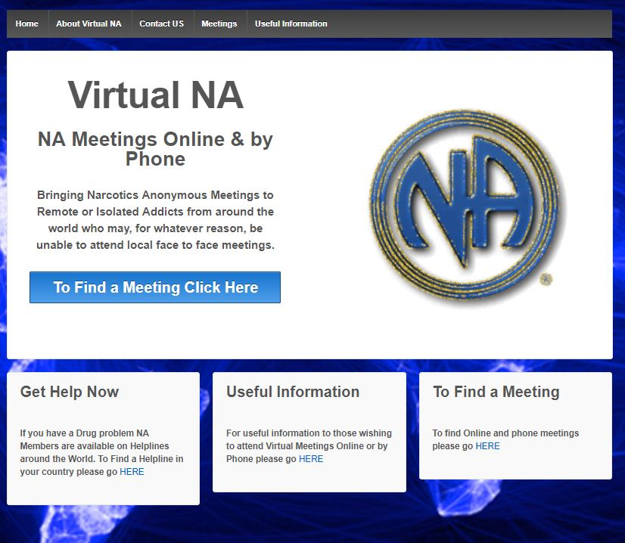

Slide 3
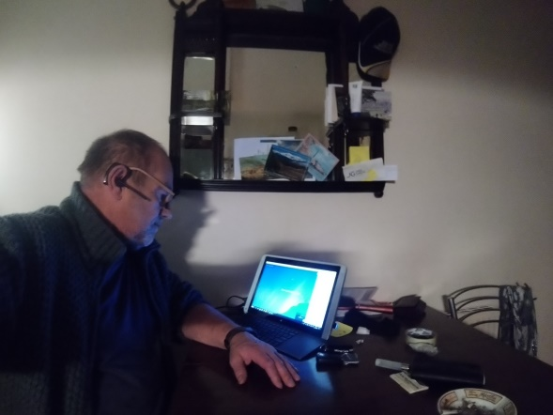
www.virtual-na.org
What are Virtual Recovery Meetings.

Slide 4
Virtual Recovery meetings are regular meetings of Narcotics Anonymous who meet via internet connections or on your phone.

Slide 5
Online recovery meetings can be accessed on PC’s, Mac’s, Tablets, iPads, iPhones, Androids and landlines.

Slide 6
Phone line recovery meetings are accessed via mobiles or landlines

Slide 7
Virtual online meetings are free to attend via various apps such as Bluejeans and Zoom.

Slide 8
Calling into phone line and online recovery meetings on your phone are charged at the applicable rate as set by your telephone service provider.

Slide 9
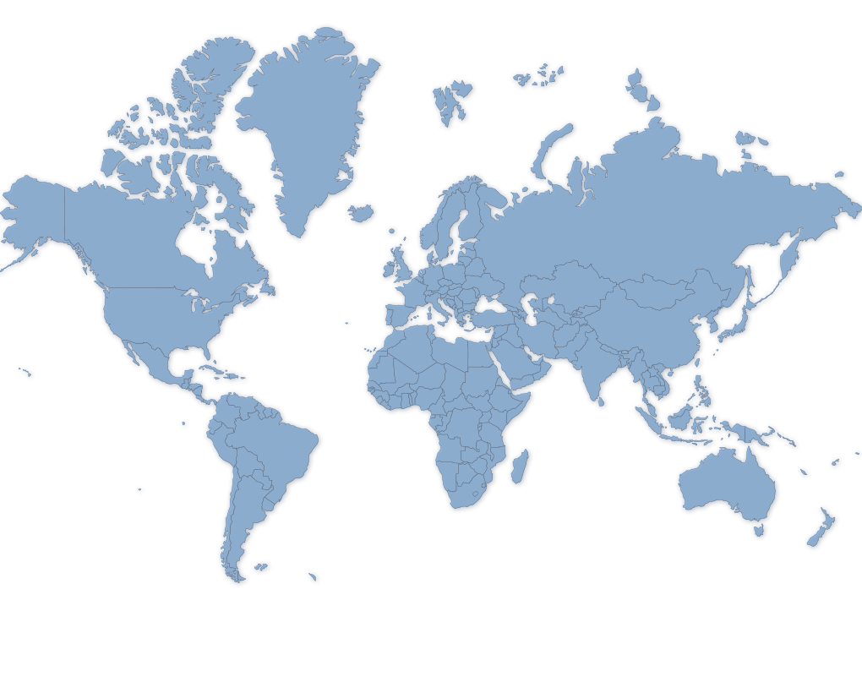
UK English Online meetings
US Phoneline meetings
US English Online meetings
Australian English
Online meetings
Virtual NA recovery meetings are popping up across the world

Slide 10
UK English Online meetings
US Phoneline meetings
US English Online meetings
Portuguese
Online Meetings
Spanish
Online Meetings
Portuguese
Online Meetings
Spanish
Online Meetings
Australian
Online meetings
Virtual NA meetings are popping up across the world

Slide 11
UK English Online meetings
US Phoneline meetings
French Online and
Phone line meetings
Italian
Online meetings
US English Online meetings
Portuguese
Online Meetings
Spanish
Online Meetings
Portuguese
Online Meetings
Spanish
Online Meetings
Australian
Online meetings
Virtual NA recovery meetings are popping up across the world

Slide 12
UK English Online meetings
US Phoneline meetings
French Online and
Phone line meetings
Italian
Online meetings
US English Online meetings
Portuguese
Online Meetings
Spanish
Online Meetings
Portuguese
Online Meetings
Spanish
Online Meetings
Australian
Online meetings
South African
Online Meetings
Virtual NA recovery meetings are popping up across the world

Slide 13
Russian
Online meetings
UK English Online meetings
US Phoneline meetings
French Online and
Phone line meetings
Italian
Online meetings
US English Online meetings
Portuguese
Online Meetings
Spanish
Online Meetings
Portuguese
Online Meetings
Spanish
Online Meetings
Australian
Online meetings
South African
Online Meetings
Virtual NA recovery meetings are popping up across the world

Slide 14
Russian
Online meetings
UK English Online meetings
US Phoneline meetings
French Online and
Phone line meetings
Italian
Online meetings
US English Online meetings
Portuguese
Online Meetings
Nepalese
Online meetings
Spanish
Online Meetings
Portuguese
Online Meetings
Spanish
Online Meetings
Australian
Online meetings
South African
Online Meetings
Virtual NA recovery meetings are popping up across the world

Slide 15
Russian
Online meetings
Canada English Online meetings
UK English Online meetings
US Phoneline meetings
French Online and
Phone line meetings
Italian
Online meetings
US English Online meetings
Portuguese
Online Meetings
Spanish
Online Meetings
Nepalese
Online meetings
Portuguese
Online Meetings
Spanish
Online Meetings
Australian
Online meetings
South African
Online Meetings
Virtual NA recovery meetings are popping up across the world

Slide 16
Reaching out to addicts in need.

Slide 17
Virtual NA
NA Meetings Online & by Phone
Bringing Narcotics Anonymous Meetings to Remote or Isolated Addicts from around the world who may, for whatever reason, be unable to attend local face to face meetings.

Slide 18
www.virtual-na.org lists over 250 meetings of Narcotics Anonymous who meet weekly via the internet or by phone

Slide 19
How do Virtual NA Recovery Meetings work?
They are just like any other regular meeting of
Narcotics Anonymous

Slide 20








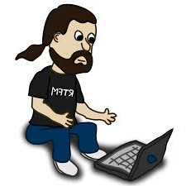


Except members meet online or by phone from around the world

Slide 21
Virtual NA recovery meetings use the same readings

Slide 22
Work the same Steps and Traditions

Slide 23
Read from the same literature

Slide 24
And follow the same basic group guidelines as any other meetings of Narcotics Anonymous

Slide 25
As with all other regular meetings of NA there are many different formats of Virtual recovery meetings

Slide 26
Speaker meetings

Slide 27
Literature discussion meetings,

Slide 28
Just for today meetings, and many more……

Slide 29
Some meetings also beam meetings in institutions or welcome institutions to attend their regularly scheduled meetings.

Slide 30
There are three main categories of Virtual meetings
Autonomous self supporting meetings
These are the most common types of meetings in Narcotics Anonymous

Slide 31
There are three main categories of Virtual meetings
Autonomous self supporting meetings

Slide 32
Autonomous self supporting meetings
They meet regularly at the same time and place and usually have a set format.

Slide 33
Autonomous self supporting meetings
Each meeting or group has a number of regular members who collectively manage the business of the meeting as trusted servants.

Slide 34
Autonomous self supporting meetings
In the case of virtual meetings these regular members do things such as hosting and chairing the meeting, make announcements about group and NA business, represent the conscience of the meeting at the next level of service and announce the ways that members may make Tradition 7 contributions. They will also direct members to sources of other NA meetings and NA literature.

Slide 35
Autonomous self supporting meetings
The primary function of the groups trusted servants is to ensure that the meeting remains positive by maintaining a good atmosphere of recovery and that it is carrying a clear Narcotics Anonymous message.

Slide 36
Hybrid Meetings

Slide 37
Hybrid Meetings
Hybrid meetings are those that are hosted via an internet connection from a physical meeting location and enable small or isolated face to face meetings to allow for members to attend virtually.

Slide 38
Hybrid Meetings
This can help to bring a wider and more diverse message of recovery to small communities.

Slide 39
Hybrid Meetings
Hybrid meetings are usually funded from the Tradition 7 funds of the local meetings who host them

Slide 40
Outreach or Fellowship Development Meetings

Slide 41
Outreach or Fellowship Development Meetings
Outreach or Fellowship Development meetings are virtual recovery meetings that are hosted and funded by local or regional Service Committees

Slide 42
Outreach or Fellowship Development Meetings
Their primary function is to provide meetings of Narcotics Anonymous to outlying or isolated communities in the country or location they are in.

Slide 43
Outreach or Fellowship Development Meetings
They also serve to allow isolated members to see how NA meetings work in the hope that those members might then go on to attend or establish physical meeting in their own local communities.

Slide 44
Outreach or Fellowship Development Meetings
It is of course inevitable that as with all virtual recovery meetings members from around the world will also find and attend them, which for newly developing NA communities can bring the benefit of having more experienced members able too share their own messages of recovery and service experience.

Slide 45

All Virtual recovery meetings believe this to be true….that
……..and all work to fulfil our Primary Purpose
To carry the Narcotics Anonymous message of Recovery to the addict who still suffers.

Slide 46
What our members say

Slide 47
Video Clip Australia

Slide 48
What our members say

Slide 49
Video Clip UK

Slide 50
What our members say

Slide 51
Video Clip USA

Slide 52
What our members say

Slide 53
Video Clip Italy etc…..

Slide 54
What our members say

Slide 55
Who can we reach?

Slide 56
Hospitals & Insitutions

Slide 57
What our members say

Slide 58
Prisons

Slide 59
What our members say

Slide 60
Treatment Centres

Slide 61
What our members say

Slide 62
Addiction Services

Slide 63
What our members say

Slide 64
Probation Services

Slide 65
What our members say

Slide 66
What our members say

Slide 67
Health Services

Slide 68
What our members say

Slide 69
Contacts

Slide 70
What our members say

Slide 71

Keep Coming Back
Thank you for watching and we hope to welcome you to a meeting on a device near you soon ☺

